Slide 1
Description of the entries in the Journal file and procedure to generate new runs
Luca di Mare
St John’s College
Oxford Thermofluids Institute
Engineering Science Department
University of Oxford

Slide 2
Purpose of this document
Describe entries in the journal file
Describe entries in the driver.m file
Procedure to start new runs

Slide 3
Project1.jou entries
/file/set-batch-options no no no
/file/import/fidap "naca0012.FDNEUT"
/define/boundary-conditions/modify-zones/zone-type 1 fluid
/define/models/solver/density-based-implicit yes
/define/models/energy? yes yes yes
/define/models/viscous/inviscid yes
/define/materials/change-create air air yes ideal-gas no no no no
/mesh/modify-zones/sep-face-zone-angle 2 30 yes
/define/boundary-conditions/zone-name 2 sym1
/define/boundary-conditions/zone-name 5 wing
/define/boundary-conditions/zone-name 6 far1
/define/boundary-conditions/zone-name 7 sym2
/define/boundary-conditions/zone-name 8 far2
/define/boundary-conditions/zone-type 6 pressure-far-field
/define/boundary-conditions/zone-type 8 pressure-far-field
/define/boundary-conditions/zone-type 2 symmetry
/define/boundary-conditions/zone-type 7 symmetry
/define/boundary-conditions/pressure-far-field far1 no 0 no 0.1 no 300 yes no 1 no 0 no 0
/define/boundary-conditions/pressure-far-field far2 no 0 no 0.1 no 300 yes no 1 no 0 no 0
/solve/initialize/compute-defaults/pressure-far-field far1
/solve/initialize/initialize-flow
/solve/monitors/residual/convergence-criteria 1.e-9 1.e-9 1.e-9 1.e-9 1.e-9
/solve/iterate 10
/file/write-case-data project1
/file/export/ascii "./surface.dat" wing () no pressure mach-number quit no
/exit

Slide 4
Project1.jou entries
Startup – no need to change
/file/set-batch-options no no no
/file/import/fidap "naca0012.FDNEUT"
/define/boundary-conditions/modify-zones/zone-type 1 fluid
/define/models/solver/density-based-implicit yes
/define/models/energy? yes yes yes
/define/models/viscous/inviscid yes
/define/materials/change-create air air yes ideal-gas no no no no
/mesh/modify-zones/sep-face-zone-angle 2 30 yes
/define/boundary-conditions/zone-name 2 sym1
/define/boundary-conditions/zone-name 5 wing
/define/boundary-conditions/zone-name 6 far1
/define/boundary-conditions/zone-name 7 sym2
/define/boundary-conditions/zone-name 8 far2
/define/boundary-conditions/zone-type 6 pressure-far-field
/define/boundary-conditions/zone-type 8 pressure-far-field
/define/boundary-conditions/zone-type 2 symmetry
/define/boundary-conditions/zone-type 7 symmetry
/define/boundary-conditions/pressure-far-field far1 no 0 no 0.1 no 300 yes no 1 no 0 no 0
/define/boundary-conditions/pressure-far-field far2 no 0 no 0.1 no 300 yes no 1 no 0 no 0
/solve/initialize/compute-defaults/pressure-far-field far1
/solve/initialize/initialize-flow
/solve/monitors/residual/convergence-criteria 1.e-9 1.e-9 1.e-9 1.e-9 1.e-9
/solve/iterate 10
/file/write-case-data project1
/file/export/ascii "./surface.dat" wing () no pressure mach-number quit no
/exit

Slide 5
Project1.jou entries
/file/set-batch-options no no no
/file/import/fidap "naca0012.FDNEUT"
/define/boundary-conditions/modify-zones/zone-type 1 fluid
/define/models/solver/density-based-implicit yes
/define/models/energy? yes yes yes
/define/models/viscous/inviscid yes
/define/materials/change-create air air yes ideal-gas no no no no
/mesh/modify-zones/sep-face-zone-angle 2 30 yes
/define/boundary-conditions/zone-name 2 sym1
/define/boundary-conditions/zone-name 5 wing
/define/boundary-conditions/zone-name 6 far1
/define/boundary-conditions/zone-name 7 sym2
/define/boundary-conditions/zone-name 8 far2
/define/boundary-conditions/zone-type 6 pressure-far-field
/define/boundary-conditions/zone-type 8 pressure-far-field
/define/boundary-conditions/zone-type 2 symmetry
/define/boundary-conditions/zone-type 7 symmetry
/define/boundary-conditions/pressure-far-field far1 no 0 no 0.1 no 300 yes no 1 no 0 no 0
/define/boundary-conditions/pressure-far-field far2 no 0 no 0.1 no 300 yes no 1 no 0 no 0
/solve/initialize/compute-defaults/pressure-far-field far1
/solve/initialize/initialize-flow
/solve/monitors/residual/convergence-criteria 1.e-9 1.e-9 1.e-9 1.e-9 1.e-9
/solve/iterate 10
/file/write-case-data project1
/file/export/ascii "./surface.dat" wing () no pressure mach-number quit no
/exit
Load file with the grid – no need to change

Slide 6
Project1.jou entries
/file/set-batch-options no no no
/file/import/fidap "naca0012.FDNEUT"
/define/boundary-conditions/modify-zones/zone-type 1 fluid
/define/models/solver/density-based-implicit yes
/define/models/energy? yes yes yes
/define/models/viscous/inviscid yes
/define/materials/change-create air air yes ideal-gas no no no no
/mesh/modify-zones/sep-face-zone-angle 2 30 yes
/define/boundary-conditions/zone-name 2 sym1
/define/boundary-conditions/zone-name 5 wing
/define/boundary-conditions/zone-name 6 far1
/define/boundary-conditions/zone-name 7 sym2
/define/boundary-conditions/zone-name 8 far2
/define/boundary-conditions/zone-type 6 pressure-far-field
/define/boundary-conditions/zone-type 8 pressure-far-field
/define/boundary-conditions/zone-type 2 symmetry
/define/boundary-conditions/zone-type 7 symmetry
/define/boundary-conditions/pressure-far-field far1 no 0 no 0.1 no 300 yes no 1 no 0 no 0
/define/boundary-conditions/pressure-far-field far2 no 0 no 0.1 no 300 yes no 1 no 0 no 0
/solve/initialize/compute-defaults/pressure-far-field far1
/solve/initialize/initialize-flow
/solve/monitors/residual/convergence-criteria 1.e-9 1.e-9 1.e-9 1.e-9 1.e-9
/solve/iterate 10
/file/write-case-data project1
/file/export/ascii "./surface.dat" wing () no pressure mach-number quit no
/exit
Tell Fluent the volume is occupied by a fluid – no need to change

Slide 7
Project1.jou entries
/file/set-batch-options no no no
/file/import/fidap "naca0012.FDNEUT"
/define/boundary-conditions/modify-zones/zone-type 1 fluid
/define/models/solver/density-based-implicit yes
/define/models/energy? yes yes yes
/define/models/viscous/inviscid yes
/define/materials/change-create air air yes ideal-gas no no no no
/mesh/modify-zones/sep-face-zone-angle 2 30 yes
/define/boundary-conditions/zone-name 2 sym1
/define/boundary-conditions/zone-name 5 wing
/define/boundary-conditions/zone-name 6 far1
/define/boundary-conditions/zone-name 7 sym2
/define/boundary-conditions/zone-name 8 far2
/define/boundary-conditions/zone-type 6 pressure-far-field
/define/boundary-conditions/zone-type 8 pressure-far-field
/define/boundary-conditions/zone-type 2 symmetry
/define/boundary-conditions/zone-type 7 symmetry
/define/boundary-conditions/pressure-far-field far1 no 0 no 0.1 no 300 yes no 1 no 0 no 0
/define/boundary-conditions/pressure-far-field far2 no 0 no 0.1 no 300 yes no 1 no 0 no 0
/solve/initialize/compute-defaults/pressure-far-field far1
/solve/initialize/initialize-flow
/solve/monitors/residual/convergence-criteria 1.e-9 1.e-9 1.e-9 1.e-9 1.e-9
/solve/iterate 10
/file/write-case-data project1
/file/export/ascii "./surface.dat" wing () no pressure mach-number quit no
/exit
Use density based, implicit solver, i.e. the type of solvers we spoke about yesterday – don’t change

Slide 8
Project1.jou entries
/file/set-batch-options no no no
/file/import/fidap "naca0012.FDNEUT"
/define/boundary-conditions/modify-zones/zone-type 1 fluid
/define/models/solver/density-based-implicit yes
/define/models/energy? yes yes yes
/define/models/viscous/inviscid yes
/define/materials/change-create air air yes ideal-gas no no no no
/mesh/modify-zones/sep-face-zone-angle 2 30 yes
/define/boundary-conditions/zone-name 2 sym1
/define/boundary-conditions/zone-name 5 wing
/define/boundary-conditions/zone-name 6 far1
/define/boundary-conditions/zone-name 7 sym2
/define/boundary-conditions/zone-name 8 far2
/define/boundary-conditions/zone-type 6 pressure-far-field
/define/boundary-conditions/zone-type 8 pressure-far-field
/define/boundary-conditions/zone-type 2 symmetry
/define/boundary-conditions/zone-type 7 symmetry
/define/boundary-conditions/pressure-far-field far1 no 0 no 0.1 no 300 yes no 1 no 0 no 0
/define/boundary-conditions/pressure-far-field far2 no 0 no 0.1 no 300 yes no 1 no 0 no 0
/solve/initialize/compute-defaults/pressure-far-field far1
/solve/initialize/initialize-flow
/solve/monitors/residual/convergence-criteria 1.e-9 1.e-9 1.e-9 1.e-9 1.e-9
/solve/iterate 10
/file/write-case-data project1
/file/export/ascii "./surface.dat" wing () no pressure mach-number quit no
/exit
Solve for the energy equation – don’t change

Slide 9
Project1.jou entries
/file/set-batch-options no no no
/file/import/fidap "naca0012.FDNEUT"
/define/boundary-conditions/modify-zones/zone-type 1 fluid
/define/models/solver/density-based-implicit yes
/define/models/energy? yes yes yes
/define/models/viscous/inviscid yes
/define/materials/change-create air air yes ideal-gas no no no no
/mesh/modify-zones/sep-face-zone-angle 2 30 yes
/define/boundary-conditions/zone-name 2 sym1
/define/boundary-conditions/zone-name 5 wing
/define/boundary-conditions/zone-name 6 far1
/define/boundary-conditions/zone-name 7 sym2
/define/boundary-conditions/zone-name 8 far2
/define/boundary-conditions/zone-type 6 pressure-far-field
/define/boundary-conditions/zone-type 8 pressure-far-field
/define/boundary-conditions/zone-type 2 symmetry
/define/boundary-conditions/zone-type 7 symmetry
/define/boundary-conditions/pressure-far-field far1 no 0 no 0.1 no 300 yes no 1 no 0 no 0
/define/boundary-conditions/pressure-far-field far2 no 0 no 0.1 no 300 yes no 1 no 0 no 0
/solve/initialize/compute-defaults/pressure-far-field far1
/solve/initialize/initialize-flow
/solve/monitors/residual/convergence-criteria 1.e-9 1.e-9 1.e-9 1.e-9 1.e-9
/solve/iterate 10
/file/write-case-data project1
/file/export/ascii "./surface.dat" wing () no pressure mach-number quit no
/exit
Inviscid fluid – we will change this to activate turbulence model

Slide 10
Project1.jou entries
/file/set-batch-options no no no
/file/import/fidap "naca0012.FDNEUT"
/define/boundary-conditions/modify-zones/zone-type 1 fluid
/define/models/solver/density-based-implicit yes
/define/models/energy? yes yes yes
/define/models/viscous/inviscid yes
/define/materials/change-create air air yes ideal-gas no no no no
/mesh/modify-zones/sep-face-zone-angle 2 30 yes
/define/boundary-conditions/zone-name 2 sym1
/define/boundary-conditions/zone-name 5 wing
/define/boundary-conditions/zone-name 6 far1
/define/boundary-conditions/zone-name 7 sym2
/define/boundary-conditions/zone-name 8 far2
/define/boundary-conditions/zone-type 6 pressure-far-field
/define/boundary-conditions/zone-type 8 pressure-far-field
/define/boundary-conditions/zone-type 2 symmetry
/define/boundary-conditions/zone-type 7 symmetry
/define/boundary-conditions/pressure-far-field far1 no 0 no 0.1 no 300 yes no 1 no 0 no 0
/define/boundary-conditions/pressure-far-field far2 no 0 no 0.1 no 300 yes no 1 no 0 no 0
/solve/initialize/compute-defaults/pressure-far-field far1
/solve/initialize/initialize-flow
/solve/monitors/residual/convergence-criteria 1.e-9 1.e-9 1.e-9 1.e-9 1.e-9
/solve/iterate 10
/file/write-case-data project1
/file/export/ascii "./surface.dat" wing () no pressure mach-number quit no
/exit
Treat air as ideal gas – will change for viscous runs

Slide 11
Project1.jou entries
/file/set-batch-options no no no
/file/import/fidap "naca0012.FDNEUT"
/define/boundary-conditions/modify-zones/zone-type 1 fluid
/define/models/solver/density-based-implicit yes
/define/models/energy? yes yes yes
/define/models/viscous/inviscid yes
/define/materials/change-create air air yes ideal-gas no no no no
/mesh/modify-zones/sep-face-zone-angle 2 30 yes
/define/boundary-conditions/zone-name 2 sym1
/define/boundary-conditions/zone-name 5 wing
/define/boundary-conditions/zone-name 6 far1
/define/boundary-conditions/zone-name 7 sym2
/define/boundary-conditions/zone-name 8 far2
/define/boundary-conditions/zone-type 6 pressure-far-field
/define/boundary-conditions/zone-type 8 pressure-far-field
/define/boundary-conditions/zone-type 2 symmetry
/define/boundary-conditions/zone-type 7 symmetry
/define/boundary-conditions/pressure-far-field far1 no 0 no 0.1 no 300 yes no 1 no 0 no 0
/define/boundary-conditions/pressure-far-field far2 no 0 no 0.1 no 300 yes no 1 no 0 no 0
/solve/initialize/compute-defaults/pressure-far-field far1
/solve/initialize/initialize-flow
/solve/monitors/residual/convergence-criteria 1.e-9 1.e-9 1.e-9 1.e-9 1.e-9
/solve/iterate 10
/file/write-case-data project1
/file/export/ascii "./surface.dat" wing () no pressure mach-number quit no
/exit
Split boundary surfaces – don’t change

Slide 12
Project1.jou entries
/file/set-batch-options no no no
/file/import/fidap "naca0012.FDNEUT"
/define/boundary-conditions/modify-zones/zone-type 1 fluid
/define/models/solver/density-based-implicit yes
/define/models/energy? yes yes yes
/define/models/viscous/inviscid yes
/define/materials/change-create air air yes ideal-gas no no no no
/mesh/modify-zones/sep-face-zone-angle 2 30 yes
/define/boundary-conditions/zone-name 2 sym1
/define/boundary-conditions/zone-name 5 wing
/define/boundary-conditions/zone-name 6 far1
/define/boundary-conditions/zone-name 7 sym2
/define/boundary-conditions/zone-name 8 far2
/define/boundary-conditions/zone-type 6 pressure-far-field
/define/boundary-conditions/zone-type 8 pressure-far-field
/define/boundary-conditions/zone-type 2 symmetry
/define/boundary-conditions/zone-type 7 symmetry
/define/boundary-conditions/pressure-far-field far1 no 0 no 0.1 no 300 yes no 1 no 0 no 0
/define/boundary-conditions/pressure-far-field far2 no 0 no 0.1 no 300 yes no 1 no 0 no 0
/solve/initialize/compute-defaults/pressure-far-field far1
/solve/initialize/initialize-flow
/solve/monitors/residual/convergence-criteria 1.e-9 1.e-9 1.e-9 1.e-9 1.e-9
/solve/iterate 10
/file/write-case-data project1
/file/export/ascii "./surface.dat" wing () no pressure mach-number quit no
/exit
Far field boundary conditions
Change “0.1” to the desired flight Mach number

Slide 13
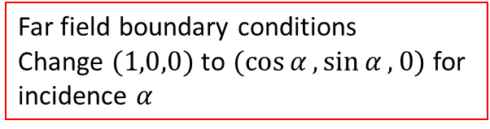
Project1.jou entries
/file/set-batch-options no no no
/file/import/fidap "naca0012.FDNEUT"
/define/boundary-conditions/modify-zones/zone-type 1 fluid
/define/models/solver/density-based-implicit yes
/define/models/energy? yes yes yes
/define/models/viscous/inviscid yes
/define/materials/change-create air air yes ideal-gas no no no no
/mesh/modify-zones/sep-face-zone-angle 2 30 yes
/define/boundary-conditions/zone-name 2 sym1
/define/boundary-conditions/zone-name 5 wing
/define/boundary-conditions/zone-name 6 far1
/define/boundary-conditions/zone-name 7 sym2
/define/boundary-conditions/zone-name 8 far2
/define/boundary-conditions/zone-type 6 pressure-far-field
/define/boundary-conditions/zone-type 8 pressure-far-field
/define/boundary-conditions/zone-type 2 symmetry
/define/boundary-conditions/zone-type 7 symmetry
/define/boundary-conditions/pressure-far-field far1 no 0 no 0.1 no 300 yes no 1 no 0 no 0
/define/boundary-conditions/pressure-far-field far2 no 0 no 0.1 no 300 yes no 1 no 0 no 0
/solve/initialize/compute-defaults/pressure-far-field far1
/solve/initialize/initialize-flow
/solve/monitors/residual/convergence-criteria 1.e-9 1.e-9 1.e-9 1.e-9 1.e-9
/solve/iterate 10
/file/write-case-data project1
/file/export/ascii "./surface.dat" wing () no pressure mach-number quit no
/exit
Far field boundary conditions
Change $(1,0,0)$ to $(\cos{α},\sin{α},0)$ for incidence $α$

Slide 14
Project1.jou entries
/file/set-batch-options no no no
/file/import/fidap "naca0012.FDNEUT"
/define/boundary-conditions/modify-zones/zone-type 1 fluid
/define/models/solver/density-based-implicit yes
/define/models/energy? yes yes yes
/define/models/viscous/inviscid yes
/define/materials/change-create air air yes ideal-gas no no no no
/mesh/modify-zones/sep-face-zone-angle 2 30 yes
/define/boundary-conditions/zone-name 2 sym1
/define/boundary-conditions/zone-name 5 wing
/define/boundary-conditions/zone-name 6 far1
/define/boundary-conditions/zone-name 7 sym2
/define/boundary-conditions/zone-name 8 far2
/define/boundary-conditions/zone-type 6 pressure-far-field
/define/boundary-conditions/zone-type 8 pressure-far-field
/define/boundary-conditions/zone-type 2 symmetry
/define/boundary-conditions/zone-type 7 symmetry
/define/boundary-conditions/pressure-far-field far1 no 0 no 0.1 no 300 yes no 1 no 0 no 0
/define/boundary-conditions/pressure-far-field far2 no 0 no 0.1 no 300 yes no 1 no 0 no 0
/solve/initialize/compute-defaults/pressure-far-field far1
/solve/initialize/initialize-flow
/solve/monitors/residual/convergence-criteria 1.e-9 1.e-9 1.e-9 1.e-9 1.e-9
/solve/iterate 10
/file/write-case-data project1
/file/export/ascii "./surface.dat" wing () no pressure mach-number quit no
/exit
Flow initialization – don’t change

Slide 15
Project1.jou entries
/file/set-batch-options no no no
/file/import/fidap "naca0012.FDNEUT"
/define/boundary-conditions/modify-zones/zone-type 1 fluid
/define/models/solver/density-based-implicit yes
/define/models/energy? yes yes yes
/define/models/viscous/inviscid yes
/define/materials/change-create air air yes ideal-gas no no no no
/mesh/modify-zones/sep-face-zone-angle 2 30 yes
/define/boundary-conditions/zone-name 2 sym1
/define/boundary-conditions/zone-name 5 wing
/define/boundary-conditions/zone-name 6 far1
/define/boundary-conditions/zone-name 7 sym2
/define/boundary-conditions/zone-name 8 far2
/define/boundary-conditions/zone-type 6 pressure-far-field
/define/boundary-conditions/zone-type 8 pressure-far-field
/define/boundary-conditions/zone-type 2 symmetry
/define/boundary-conditions/zone-type 7 symmetry
/define/boundary-conditions/pressure-far-field far1 no 0 no 0.1 no 300 yes no 1 no 0 no 0
/define/boundary-conditions/pressure-far-field far2 no 0 no 0.1 no 300 yes no 1 no 0 no 0
/solve/initialize/compute-defaults/pressure-far-field far1
/solve/initialize/initialize-flow
/solve/monitors/residual/convergence-criteria 1.e-9 1.e-9 1.e-9 1.e-9 1.e-9
/solve/iterate 10
/file/write-case-data project1
/file/export/ascii "./surface.dat" wing () no pressure mach-number quit no
/exit
Tolerance levels – note 5 values for five equations: you will need to add more entries when the number of equations increases because of turbulence models

Slide 16
Project1.jou entries
/file/set-batch-options no no no
/file/import/fidap "naca0012.FDNEUT"
/define/boundary-conditions/modify-zones/zone-type 1 fluid
/define/models/solver/density-based-implicit yes
/define/models/energy? yes yes yes
/define/models/viscous/inviscid yes
/define/materials/change-create air air yes ideal-gas no no no no
/mesh/modify-zones/sep-face-zone-angle 2 30 yes
/define/boundary-conditions/zone-name 2 sym1
/define/boundary-conditions/zone-name 5 wing
/define/boundary-conditions/zone-name 6 far1
/define/boundary-conditions/zone-name 7 sym2
/define/boundary-conditions/zone-name 8 far2
/define/boundary-conditions/zone-type 6 pressure-far-field
/define/boundary-conditions/zone-type 8 pressure-far-field
/define/boundary-conditions/zone-type 2 symmetry
/define/boundary-conditions/zone-type 7 symmetry
/define/boundary-conditions/pressure-far-field far1 no 0 no 0.1 no 300 yes no 1 no 0 no 0
/define/boundary-conditions/pressure-far-field far2 no 0 no 0.1 no 300 yes no 1 no 0 no 0
/solve/initialize/compute-defaults/pressure-far-field far1
/solve/initialize/initialize-flow
/solve/monitors/residual/convergence-criteria 1.e-9 1.e-9 1.e-9 1.e-9 1.e-9
/solve/iterate 10
/file/write-case-data project1
/file/export/ascii "./surface.dat" wing () no pressure mach-number quit no
/exit
Iteration count – reasonable value is ~2000

Slide 17
Project1.jou entries
/file/set-batch-options no no no
/file/import/fidap "naca0012.FDNEUT"
/define/boundary-conditions/modify-zones/zone-type 1 fluid
/define/models/solver/density-based-implicit yes
/define/models/energy? yes yes yes
/define/models/viscous/inviscid yes
/define/materials/change-create air air yes ideal-gas no no no no
/mesh/modify-zones/sep-face-zone-angle 2 30 yes
/define/boundary-conditions/zone-name 2 sym1
/define/boundary-conditions/zone-name 5 wing
/define/boundary-conditions/zone-name 6 far1
/define/boundary-conditions/zone-name 7 sym2
/define/boundary-conditions/zone-name 8 far2
/define/boundary-conditions/zone-type 6 pressure-far-field
/define/boundary-conditions/zone-type 8 pressure-far-field
/define/boundary-conditions/zone-type 2 symmetry
/define/boundary-conditions/zone-type 7 symmetry
/define/boundary-conditions/pressure-far-field far1 no 0 no 0.1 no 300 yes no 1 no 0 no 0
/define/boundary-conditions/pressure-far-field far2 no 0 no 0.1 no 300 yes no 1 no 0 no 0
/solve/initialize/compute-defaults/pressure-far-field far1
/solve/initialize/initialize-flow
/solve/monitors/residual/convergence-criteria 1.e-9 1.e-9 1.e-9 1.e-9 1.e-9
/solve/iterate 10
/file/write-case-data project1
/file/export/ascii "./surface.dat" wing () no pressure mach-number quit no
/exit
Save data at end of run – don’t change

Slide 18
Project1.jou entries
/file/set-batch-options no no no
/file/import/fidap "naca0012.FDNEUT"
/define/boundary-conditions/modify-zones/zone-type 1 fluid
/define/models/solver/density-based-implicit yes
/define/models/energy? yes yes yes
/define/models/viscous/inviscid yes
/define/materials/change-create air air yes ideal-gas no no no no
/mesh/modify-zones/sep-face-zone-angle 2 30 yes
/define/boundary-conditions/zone-name 2 sym1
/define/boundary-conditions/zone-name 5 wing
/define/boundary-conditions/zone-name 6 far1
/define/boundary-conditions/zone-name 7 sym2
/define/boundary-conditions/zone-name 8 far2
/define/boundary-conditions/zone-type 6 pressure-far-field
/define/boundary-conditions/zone-type 8 pressure-far-field
/define/boundary-conditions/zone-type 2 symmetry
/define/boundary-conditions/zone-type 7 symmetry
/define/boundary-conditions/pressure-far-field far1 no 0 no 0.1 no 300 yes no 1 no 0 no 0
/define/boundary-conditions/pressure-far-field far2 no 0 no 0.1 no 300 yes no 1 no 0 no 0
/solve/initialize/compute-defaults/pressure-far-field far1
/solve/initialize/initialize-flow
/solve/monitors/residual/convergence-criteria 1.e-9 1.e-9 1.e-9 1.e-9 1.e-9
/solve/iterate 10
/file/write-case-data project1
/file/export/ascii "./surface.dat" wing () no pressure mach-number quit no
/exit
Data for analysis – you could add “wall-shear” for a viscous run. The data will be in the “surface.dat” file for you to bring back to your computer and analyse with Matlab

Slide 19
Project1.jou – entries to modify
/file/set-batch-options no no no
/file/import/fidap "naca0012.FDNEUT"
/define/boundary-conditions/modify-zones/zone-type 1 fluid
/define/models/solver/density-based-implicit yes
/define/models/energy? yes yes yes
/define/models/viscous/inviscid yes
/define/materials/change-create air air yes ideal-gas no no no no
/mesh/modify-zones/sep-face-zone-angle 2 30 yes
/define/boundary-conditions/zone-name 2 sym1
/define/boundary-conditions/zone-name 5 wing
/define/boundary-conditions/zone-name 6 far1
/define/boundary-conditions/zone-name 7 sym2
/define/boundary-conditions/zone-name 8 far2
/define/boundary-conditions/zone-type 6 pressure-far-field
/define/boundary-conditions/zone-type 8 pressure-far-field
/define/boundary-conditions/zone-type 2 symmetry
/define/boundary-conditions/zone-type 7 symmetry
/define/boundary-conditions/pressure-far-field far1 no 0 no 0.1 no 300 yes no 1 no 0 no 0
/define/boundary-conditions/pressure-far-field far2 no 0 no 0.1 no 300 yes no 1 no 0 no 0
/solve/initialize/compute-defaults/pressure-far-field far1
/solve/initialize/initialize-flow
/solve/monitors/residual/convergence-criteria 1.e-9 1.e-9 1.e-9 1.e-9 1.e-9
/solve/iterate 10
/file/write-case-data project1
/file/export/ascii "./surface.dat" wing () no pressure mach-number quit no
/exit

Slide 20
function driver()
% rf spacing on the surface of the aerofoil in units of local
% curvature radius
% smax maxmum spacing along the aerofoil surface - normalised
%dy initial spacing in the wall-normal direction
%eta expansion ratio in the wall-normal direction
%dinf max spacing away from the aerofoil
%linf maximum distance from aerofoil surface
%winf maximum length of wake section
rf= 0.2;
smax=0.02;
ste= 0.01;
dy= 0.001;
dinf=0.5;
eta= 1.2;
linf=3;
winf=3;
[s,x]= naca0012();
[v0]=cgrid( s,x, rf,smax,ste, dy,eta,dinf, linf );
[v1,v2]=wake(v0,eta,dinf, winf);
% plot3D output
f= fopen( "p3d.x","w" );
fprintf( f,"%6d\n", 3 );
fprintf( f,"%6d %6d %6d\n", size(v0,2),size(v0,3), 4 );
fprintf( f,"%6d %6d %6d\n", size(v1,2),size(v1,3), 4 );
fprintf( f,"%6d %6d %6d\n", size(v2,2),size(v2,3), 4 );
plot3dout( f,v0,dinf,4 );
plot3dout( f,v1,dinf,4 );
plot3dout( f,v2,dinf,4 );
fclose( f );
end
Tangential spacing
Scale by same factor to change tangential spacing (e.g. halve or double all three values)

Slide 21
function driver()
% rf spacing on the surface of the aerofoil in units of local
% curvature radius
% smax maxmum spacing along the aerofoil surface - normalised
%dy initial spacing in the wall-normal direction
%eta expansion ratio in the wall-normal direction
%dinf max spacing away from the aerofoil
%linf maximum distance from aerofoil surface
%winf maximum length of wake section
rf= 0.2;
smax=0.02;
ste= 0.01;
dy= 0.001;
dinf=0.5;
eta= 1.2;
linf=3;
winf=3;
[s,x]= naca0012();
[v0]=cgrid( s,x, rf,smax,ste, dy,eta,dinf, linf );
[v1,v2]=wake(v0,eta,dinf, winf);
% plot3D output
f= fopen( "p3d.x","w" );
fprintf( f,"%6d\n", 3 );
fprintf( f,"%6d %6d %6d\n", size(v0,2),size(v0,3), 4 );
fprintf( f,"%6d %6d %6d\n", size(v1,2),size(v1,3), 4 );
fprintf( f,"%6d %6d %6d\n", size(v2,2),size(v2,3), 4 );
plot3dout( f,v0,dinf,4 );
plot3dout( f,v1,dinf,4 );
plot3dout( f,v2,dinf,4 );
fclose( f );
end
Normal spacing – e.g. to control spacing in boundary layer and wake

Slide 22
function driver()
% rf spacing on the surface of the aerofoil in units of local
% curvature radius
% smax maxmum spacing along the aerofoil surface - normalised
%dy initial spacing in the wall-normal direction
%eta expansion ratio in the wall-normal direction
%dinf max spacing away from the aerofoil
%linf maximum distance from aerofoil surface
%winf maximum length of wake section
rf= 0.2;
smax=0.02;
ste= 0.01;
dy= 0.001;
dinf=0.5;
eta= 1.2;
linf=3;
winf=3;
[s,x]= naca0012();
[v0]=cgrid( s,x, rf,smax,ste, dy,eta,dinf, linf );
[v1,v2]=wake(v0,eta,dinf, winf);
% plot3D output
f= fopen( "p3d.x","w" );
fprintf( f,"%6d\n", 3 );
fprintf( f,"%6d %6d %6d\n", size(v0,2),size(v0,3), 4 );
fprintf( f,"%6d %6d %6d\n", size(v1,2),size(v1,3), 4 );
fprintf( f,"%6d %6d %6d\n", size(v2,2),size(v2,3), 4 );
plot3dout( f,v0,dinf,4 );
plot3dout( f,v1,dinf,4 );
plot3dout( f,v2,dinf,4 );
fclose( f );
end
Overall domain size

Slide 23
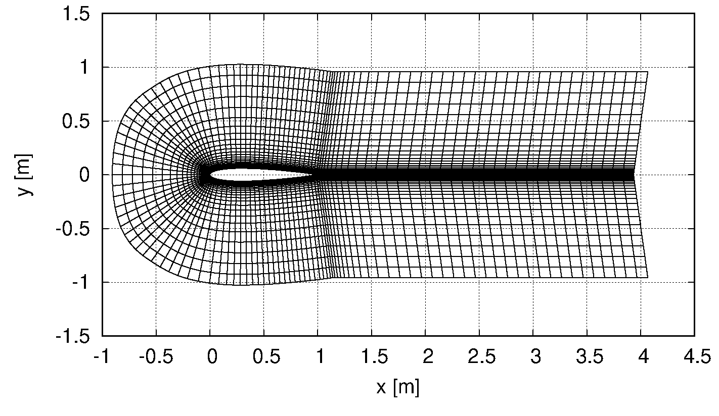
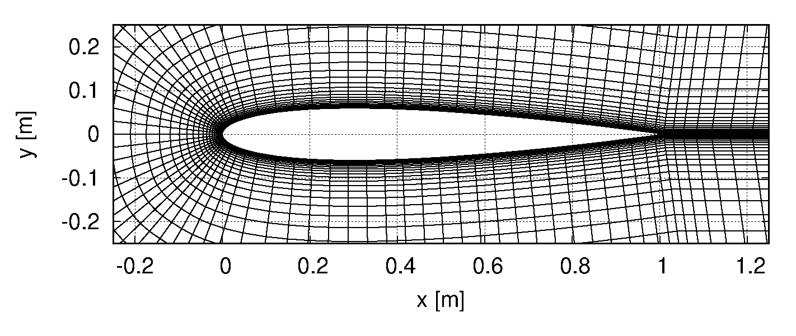
linf
winf
rf
smax
ste
dy
dinf

